Slide 1
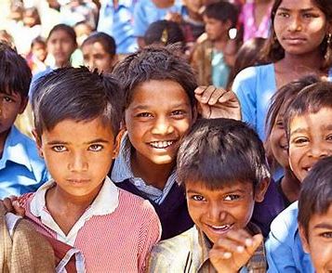
SERENITY ORPHANAGE AND ELDER CARE FACILITY
PREPARED BY-
NAIR SWAPNA SASIDHARAN(62)
AKSHAYAPOOJA A P(14)
PARVATHY S NAIR(76)
GUIDE-
APARNA P V

Slide 2
01
02
EXISTING SYSTEM AND THEIR DRAWBACKS
03
OUR SYSTEM ,ITS MERITS AND MODULES
ABOUT OUR PROJECT
04
HARDWARE AND SOFTWARE REQUIREMENTS
05
ER DIAGRAM,DFD AND TABLE DESIGN
06
CONCLUSION
CONTENT

Slide 3
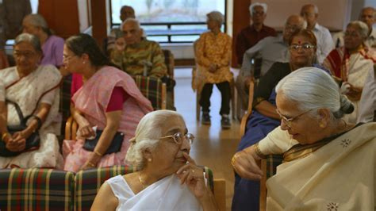
ABOUT OUR PROJECT
This project aimed at creating a user-friendly software system that will help manage the day-to-day operations of an orphanage and elder care facility. This system will simplify how the facility handles everything from resident records ,donations informations to medical and educational records of the residents.
Managing an orphanage or elder care facility can be incredibly challenging,especially when it comes to keeping track of resources, maintaining accurate records, and ensuring the residents' well-being. By developing this management system, we’re looking to offer a unified platform that makes data storage, analysis, and reporting more efficient and effective.

Slide 4
DRAWBACKS OF THE EXISTING SYSTEM
In India, most of the orphanages and elder care facilities still manage there records manually but there are few existing websites for these facilities which lack many functionality making them non user friendly and inefficient. Some of the drawbacks are :
. Manual Record Keeping
. Inefficiency and Errors
. Data Analysis Difficulties
. Lack of Empathy
. Lack of Scalability

Slide 5
The proposed system will leverage modern technologies to automate various processes, improve data accuracy, and enhance overall operational efficiency. Key benefits include:
PROPOSED SYSTEM AND ITS MERITS
. Centralized database for easy access to all information
. Automated task management and scheduling
. Multiple language option
. An intuitive software solution designed for ease of use by all stakeholders.
. The user can request the medical and educational records of the residents from the admin.

Slide 6
MODULES OF THE SYSTEM
The system will consist of the following core modules:
REGISTRATION :User should register first into the website to be able to login in
LOGIN: User and Admin would be able to login to the online facility website
RESIDENT DETAIL: Here all the details of the facility resident will be stored
DONATION DETAIL: Tools for organizing and managing community fundraising efforts and charitable donations.
APPOINTMENT SLOT: Tool the user can use to book slots to visit the facility and spend time with the Residents.
STORE DETAIL: The user can get the details about the items made and sold by the residents of the facility.
MEDICAL RECORD: This module will help the admin to send the medical records to the guardians of the resident.
EDUCATION RECORD: This module will help the admin to send the educational records to the guardians of the resident.
FEEDBACK: This module will allow the people to give feedback about their experience in the facility.

Slide 7









REQUIREMENTS
HARDWARE
SOFTWARE
Processor:
11th Gen Intel(R) Core(TM) i3-1125G4 @
2.00GHz 2.00 GHz
Installed RAM :
8.00 GB (7.65 GB usable)
System type
64-bit operating system, x64-based
processor
Programming languages:
Web framework:
DJango,Flask
Package manager:
pip
Operating system:
Windows
Database:
MySQL, SQL Server

Slide 8
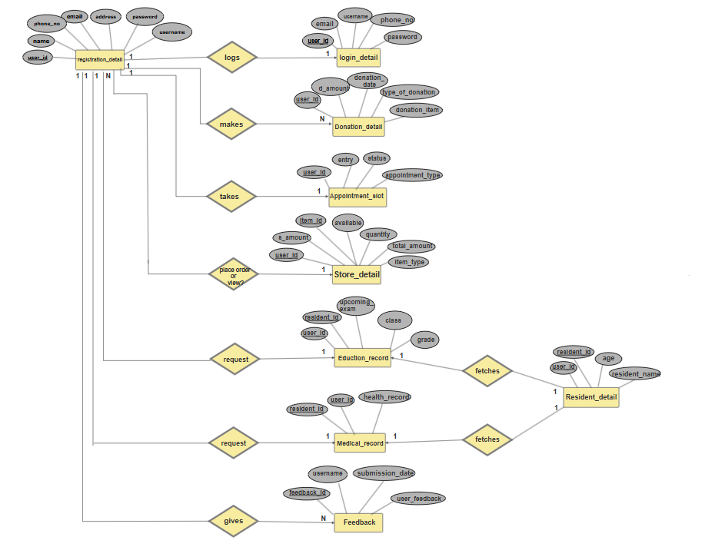
ER DIAGRAM

Slide 9
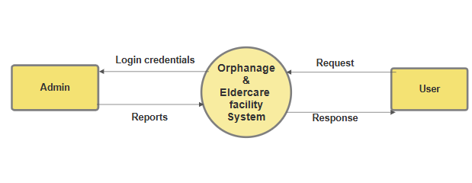
DFD LEVEL 0

Slide 10
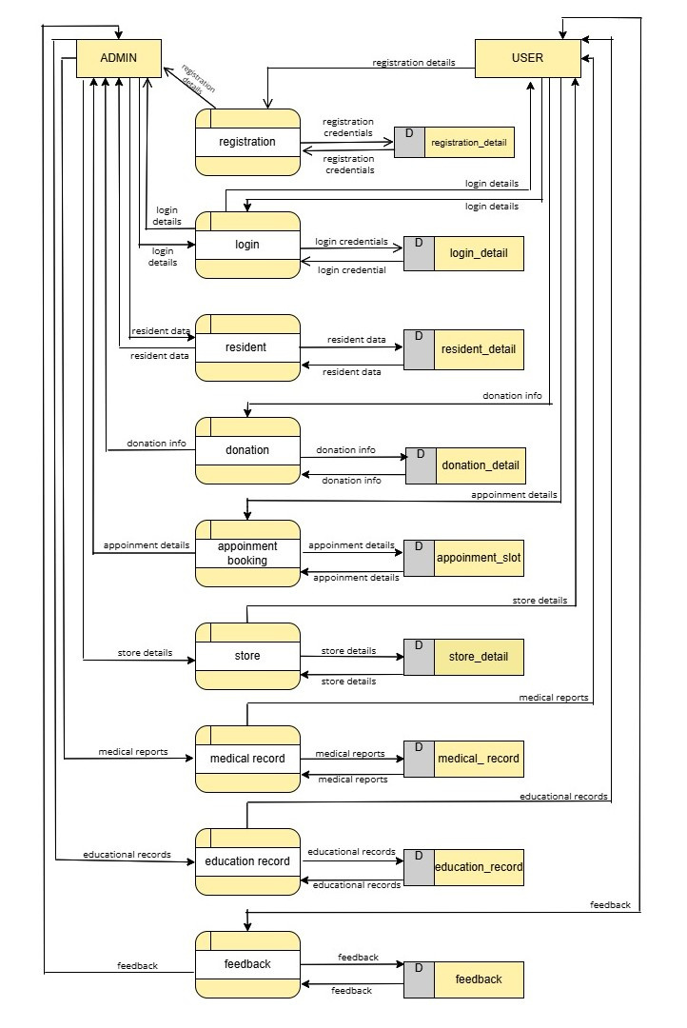
DFD LEVEL 1

Slide 11
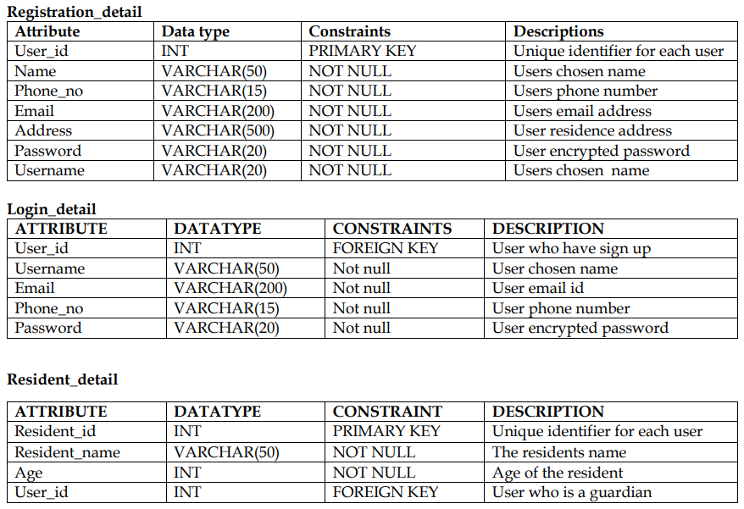
TABLE DESIGN

Slide 12
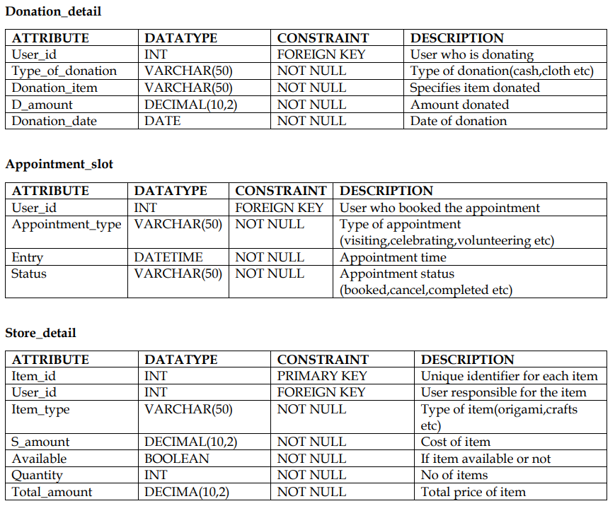
TABLE DESIGN

Slide 13
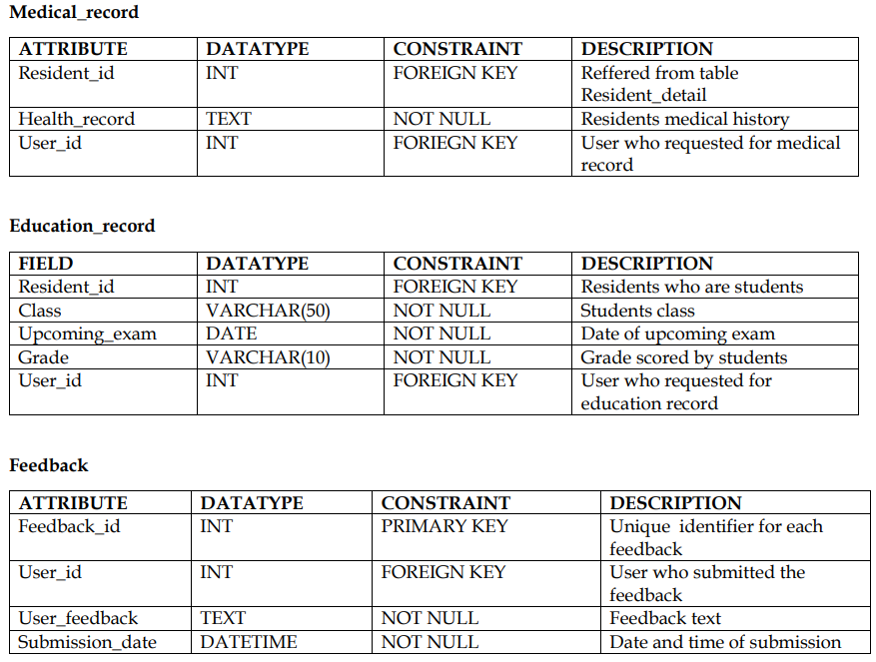
TABLE DESIGN

Slide 14
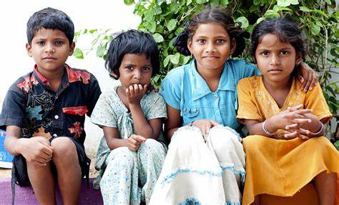
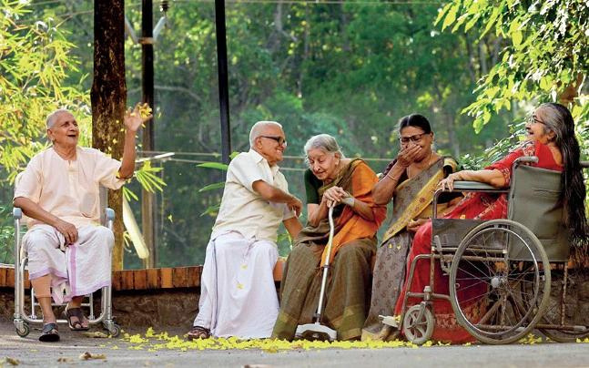
CONCLUSION
The proposed integrated management system will significantly enhance the operations of the orphanage and elder care facility by streamlining processes, improving data management, and providing valuable insights. By addressing the limitations of manual systems, this solution will contribute to the overall well-being of residents and staff.

